Slide 1


Prodapt Data Science Project:
Submitted by: Prerna Singh
University of Texas at Dallas
Date: 6th August 2022

Slide 2

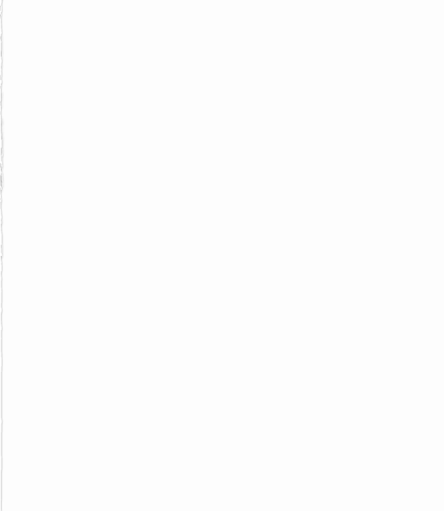

Problem Statement
The Objective of this project is to create a prediction model to help telecom operator to predict and reduce churn in customer experience.

Slide 3

Approach
Data Analysis and understanding
Exploratory Data Analysis : Data Cleaning and Preprocessing
Data Modelling: Algorithms for Prediction
Recommendation

Slide 4
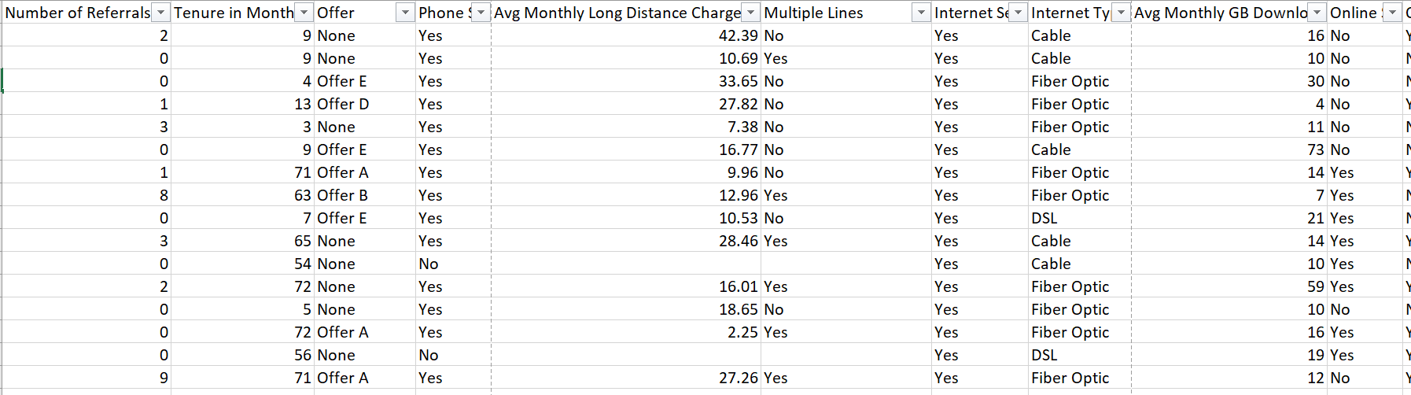
Data Analysis and understanding
Source: The data set used in this project is from Kaggle
Link : Telecom Customer Churn Prediction | Kaggle
Data Description
Total number of rows: 7043
Total number of columns: 38
Target Variable: Customer Status (Categorical)
Total number of categorical variables: 19
Total number of character variables: 7
Number of Numerical Variable: 12

Slide 5
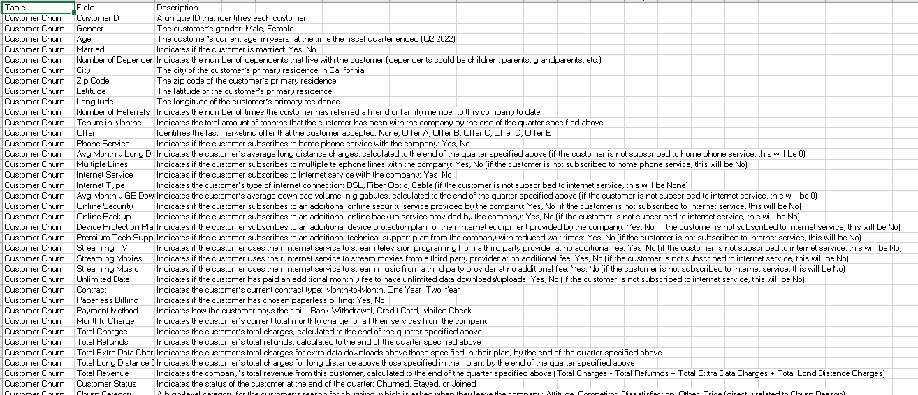
Variable Description

Slide 6
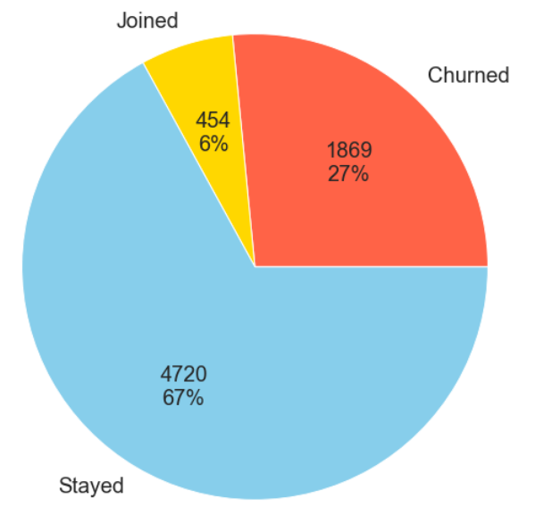
Target Variable Analysis
Target Variable: Customer Status
Type: Categorical
The target variable is divided in the following ratio:
Churned = 1869 (26.53%)
Stayed = 4720 (67.01%)
Joined = 454 (6.54%)

Slide 7
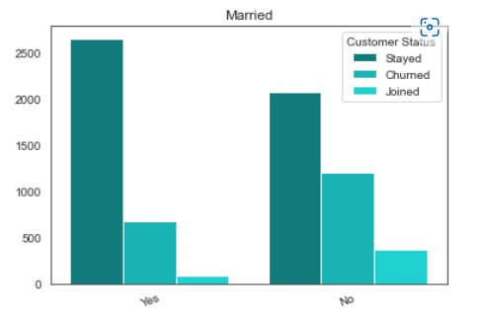
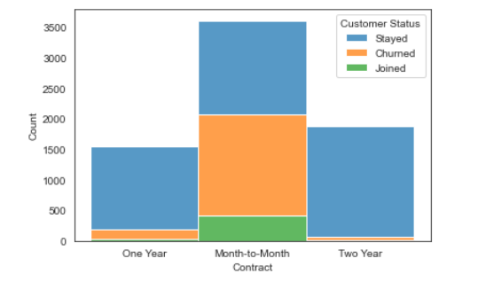
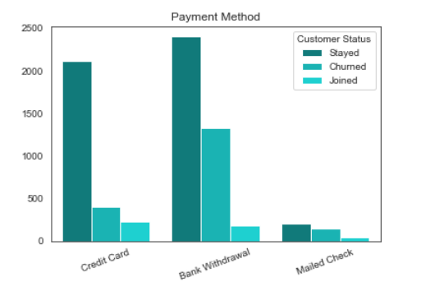
Exploratory Data Analysis Inferences
Data Cleaning: Handling Null values and dropping insignificant variables
Data Processing:
Considering majority of unmarried customers would be students, hence churning is more prominent amongst them.
Most customers are enrolled in Month-to-Month contract and have churning more, as they have more flexibility in unsubscribing.
Most churned customers are found in Bank Withdrawal method, assuming the interface was not very user friendly.

Slide 8
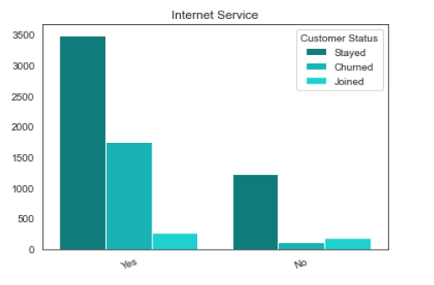
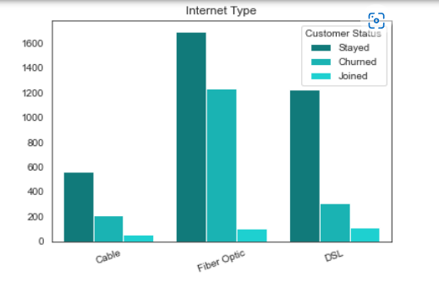
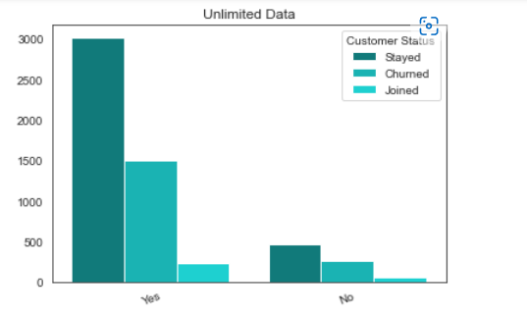
Exploratory Data Analysis Inferences
Most churned customers had taken internet services with unlimited data and Fiber optic, concluding the data services might not be economical as per the experience.

Slide 9
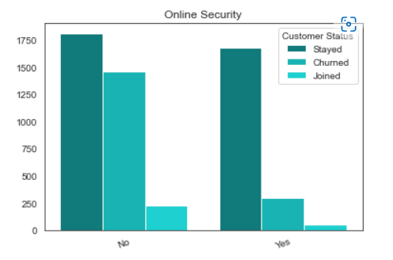
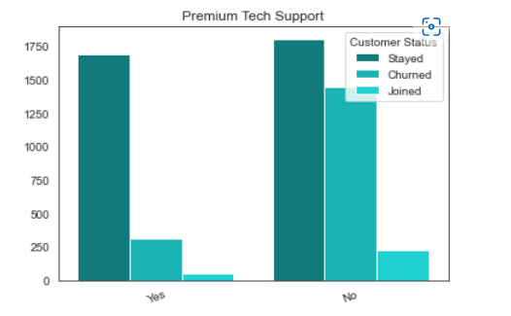
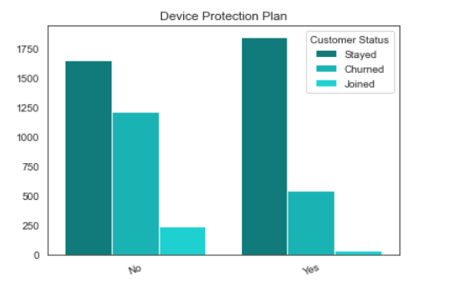
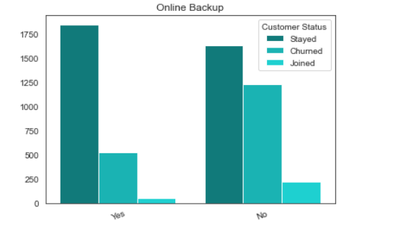
Exploratory Data Analysis Inferences
Customers who had taken the miscellaneous facilities like Online security, premium tech support, device protection plan had more churning rate.

Slide 10
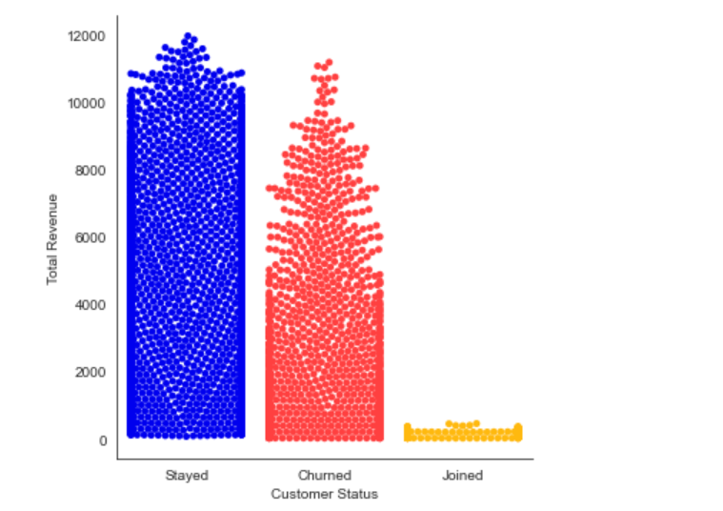
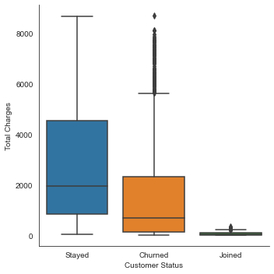
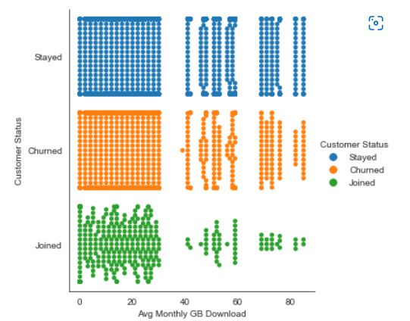
Consumption variables
Majority Churned customers had total revenue within $5000
The total revenue that churned customers made for the telecom operator was 21%.
Many outliers are found in total charges for Churned and Joined customers.
Since the customers received high charges, implies them getting churned.
Most of the customers downloaded within approximately 30GB of avg monthly GB data.
For the above consumption, the telecom operator might be getting expensive for the customers.

Slide 11
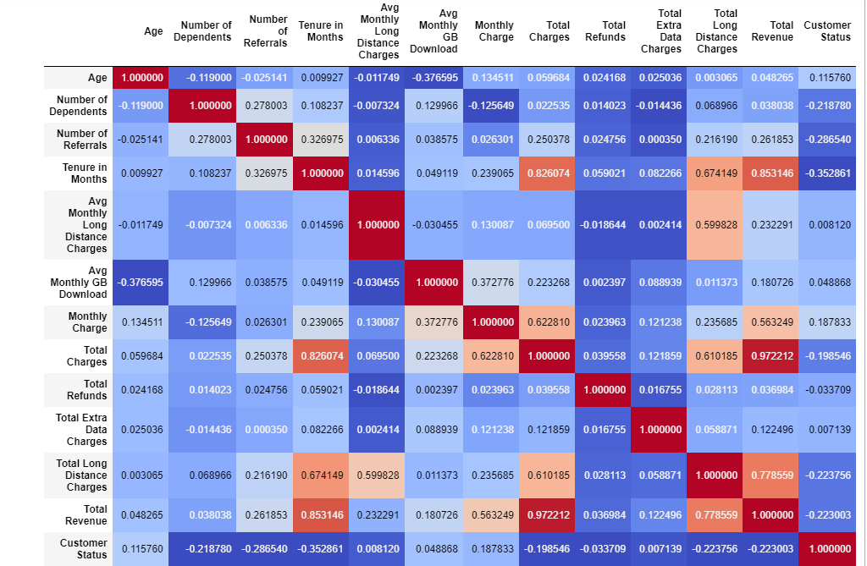
Exploratory Data Analysis Inferences
Correlation Matrix
None of the numerical variables make a strong correlation with the target variable ‘Customer Status’. However, we see Tenure month having the highest negative relation with the Customer Status.
Tenure month is also highly correlated with the Total revenue and Total charges variables.
We can conclude that churned customers were higher among lesser tenure customers.

Slide 12
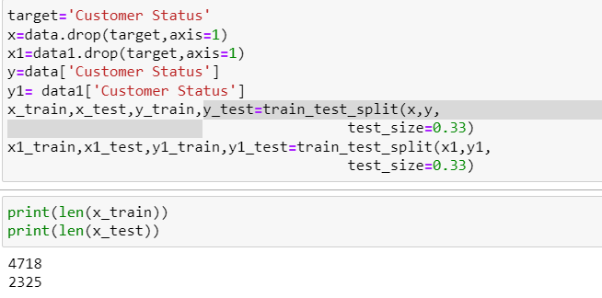
Data Modelling
Classification Models
Logistic Regression
Random Forest Classifier
Adaboost Classifier
XGBoost Classifier
Analysis of metrics such as variable of importance, confusion matrix and accuracy score to determine the best model for the prediction.
After EDA, dataset is split into train and test data for model prediction.

Slide 13
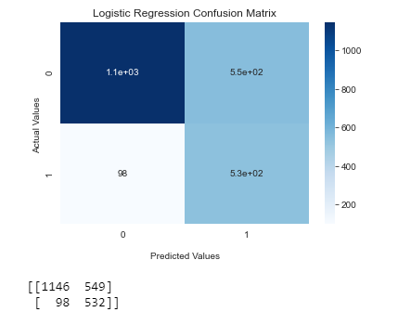
Logistic Regression
Logistic regression predicts the probability of occurrence of an event by fitting data to a logit function (hence the name Logistic regression). Logistic regression predicts probability; hence its output values lie between 0 and 1.
Accuracy Score | 72.9462
Precision Score | 72.95
Recall Score | 72.95

Slide 14
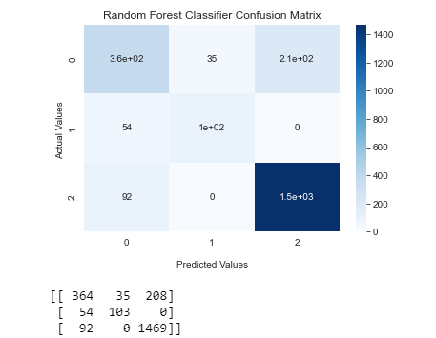
Random Forest Classifier
A random forest is a meta estimator that fits several decision tree classifiers on various sub-samples of the dataset and uses averaging to improve the predictive accuracy and control over-fitting.
Accuracy Score | 83.52688
Precision Score | 83.53
Recall Score | 83.53

Slide 15
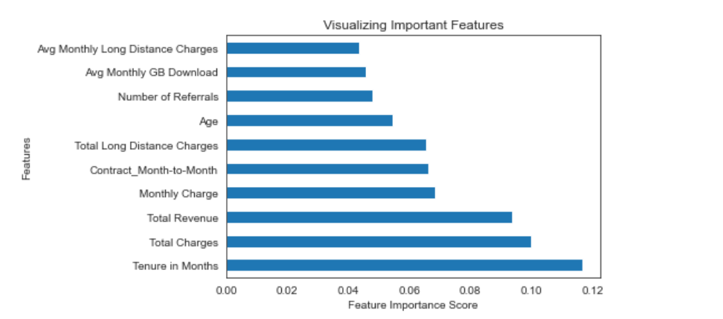
Variable Importance plot based on Random Forest Classifier

Slide 16
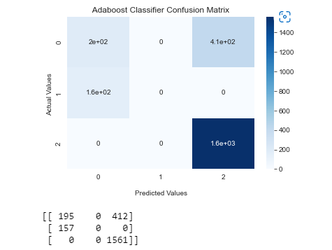
Adaboost Classifier
AdaBoost stands for ‘Adaptive Boosting’, which transforms weak learners or predictors to strong predictors in order to solve problems of classification.
Accuracy Score | 75.182795
Precision Score | 75.18
Recall Score | 75.18

Slide 17
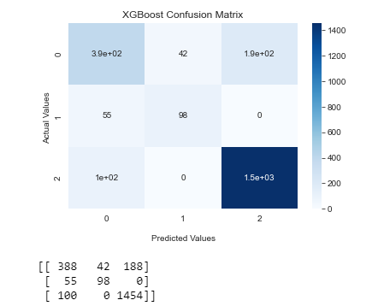
XGBoost Classifier
XGBoost is an implementation of gradient boosted decision trees designed for speed and performance..
Accuracy Score | 84.0
Precision Score | 84.0
Recall Score | 84.0

Slide 18

Recommendations
With highest accuracy score and recall, XGBoost makes the best model to be used for prediction of the churned customers.
From EDA inferences, we found how tenure months is strongly correlated with total revenue and total charges and in weak negative correlation with the Customer Status(Churned) and from Random Forest Classifier as well, we can conclude Tenure months stands the most important variable. Telecom operator could monitor the experience of customers with less tenure.
Telecom operator could be careful in prices and providing service to the customers who have enrolled in other miscellaneous facilities like Premium Tech support, online security
Telecom operator could improve upon its charges for retaining of the customers.

Slide 19
Thank You

